Slide 1
Antisense to medicine: a regulator’s perspective
Dr. Marjon Pasmooij
1st Dutch Antisense Therapeutis Symposium, 3 June 2022

Slide 2
Antisense to Medicine
Outline presentation
1.
Regulatory context
2.
Approved ASO’s
3.
Support tools

Slide 3

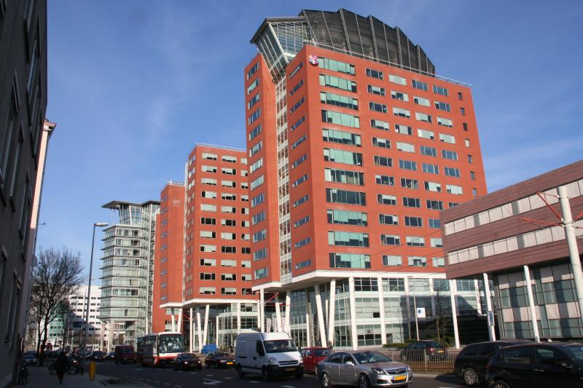
1. Regulatory context
European Medicines Agency
          Responsible for the scientific evaluation and supervision of medicines developed for use in EU
          Scientific evaluation done by 27 Member States – national medicines regulatory authorities (4500 experts)
            EMA, Amsterdam
            CBG, Utrecht

Slide 4
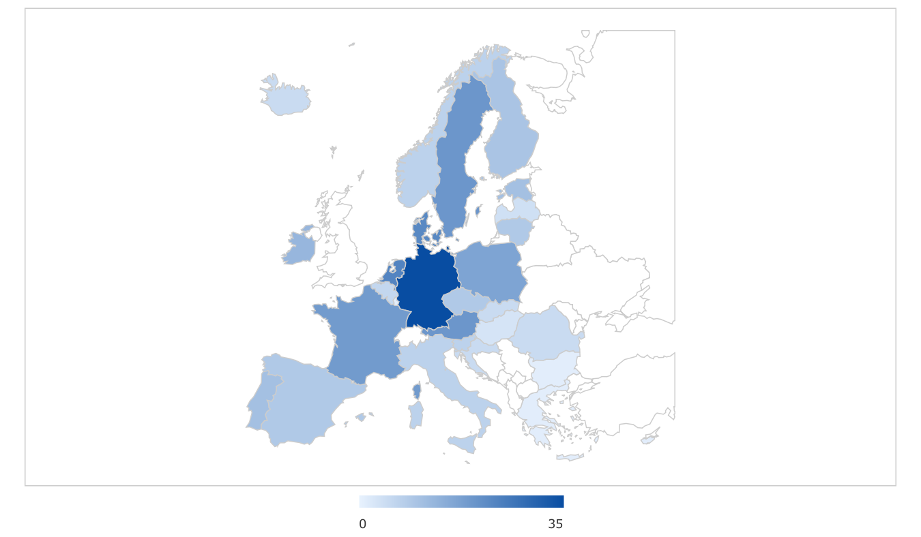
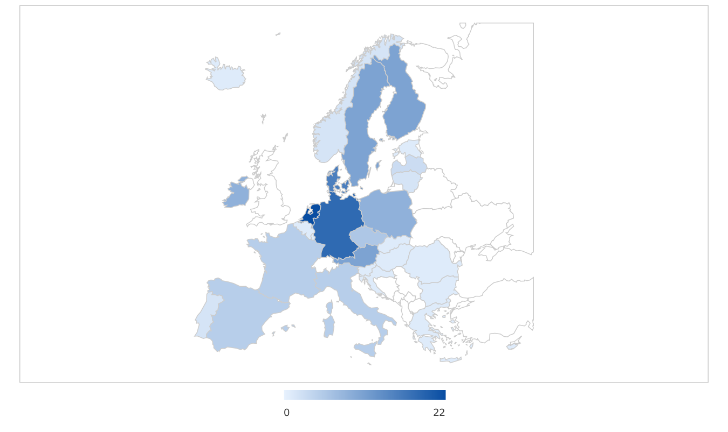
Rapporteurships
          Rapporteurships 2021 - CHMP
          Rapporteurships 2021 - PRAC

Slide 5
The evaluation phase - how does it work?
The Applicant submits an application for registration, together with a registration dossier.
The assessment team of the Rapporteur and Co-rapporteur of the NCAs write the assessment reports.
The reports are discussed at the corresponding committee of EMA (CHMP, CAT, COMP, PRAC)
The opinion of the EMA committees is sent to the EC
The EC grants a marketing authorization

Slide 6
Steps of the Centralised Procedure
Orphan
Paediatrics
Filing strategy
D.120
D.121
D.180
D.181
D.210
D.277
Pre-submission
Primary
Evaluation
Secondary
Evaluation
Final
Evaluation
Clock
Stop
Clock
Stop
Opinion
Decision
LoQ
LoOI
Post Authorisation
-7/6m Pre-submission meeting
Responses
Responses
-7m rapporteurs appoint.
-Pharmacovigilance
-Variations
-Extensions
-Renewal
SmPC, PL, labelling, Risk min. measures,
conditions
to MA
Rap/Co-Rap
Day 80 AR
Day 150 AR
on responses
-18 to -7m
-12 to -36m

Slide 7
2. Approved ASOs
Experience with therapeutic oligonucleotides
          Mainly antisense oligonucleotides
          Very limited siRNAs
  What are they used for?
          Currently primarily targeted at rare diseases (orphan diseases)
            Limits information on safety (and efficacy)

Slide 8
Drug | Indication | Approval status EMA | Approval status FDA | Adm route
Fomivirsen | Cytomegolovirus retinitis | 1999 (withdrawn 2002 request MAH) | 1998 | Intravitreal
Pegaptanib | Age-related Macular degeneration | 2006 (withdrawn 2016 request MAH) | 2004 | Intravitreal
Mipomersen | Homozygous familial hypercholesterolemia | Refused | 2013 | Subcutaneous
Defibrotide | Severe hepatic veno-occlusive disease after stemcell transplantation | 2013 | 2016 | Intravenous
Drisapersen | Duchenne muscular dystrophy | Withdrawn during MA application | Refused | Subcutaneous
Eteplirsen | Duchenne muscular dystrophy (exon 51 skipping) | Refused | 2016 | Intravenous
Nusinersen | Spinal muscular atrophy | 2017 | 2016 | Intrathecal
Inotersen | Hereditary transthyretin amyloidosis | 2018 | 2018 | Subcutaneous
Volanesorsen | Familial chylomicronemia syndrome | 2019 | Refused | Subcutaneous
Golodirsen | Duchenne muscular dystrophy (exon 53 skipping) | - | 2019 | Intravenous
Viltolarsen | Duchenne muscular dystrophy (exon 53 skipping) | - | 2020 | Intravenous
Casimersen | Duchenne muscular dystrophy (exon 45 skipping) | - | 2021 | Intravenous
Notes:
approved to treat Duchenne muscular dystrophy in 2016. But the confirmational trials stipulated by the FDA were not even begun until four years later.

Slide 9
Approved siRNAs
Drug | Indication | Approval status EMA | Approval status FDA | Adm route
Patisiran | Hereditary transthyretin amyloidosis | 2018 | 2018 | Intravenous
Givosiran | Acute hepatic porphyria | 2020 | 2019 | Subcutaneous
Inclisiran | Primary hypercholesterolaemia or mixed dyslipidaemia | 2020 | 2021 | Subcutaneous
Lumasiran | Primary hyperoxaluria type 1 | 2020 | 2020 | Subcutaneous

Slide 10
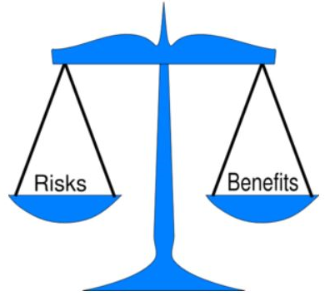
ASO approvals
Several non-approved AONs
          Voluntary withdrawal
            Commercial reasons
            Unable to address concerns during MAA
          Negative benefit risk ratio
            Challenges in assessment of the benefit risk ratio
              Difference in approvals FDA and EMA
            Uncertainty on efficacy
              (very) limited data
              Clinical implications
            Uncertainty on safety
              Limited data
              Uncertain long term consequences

Slide 11
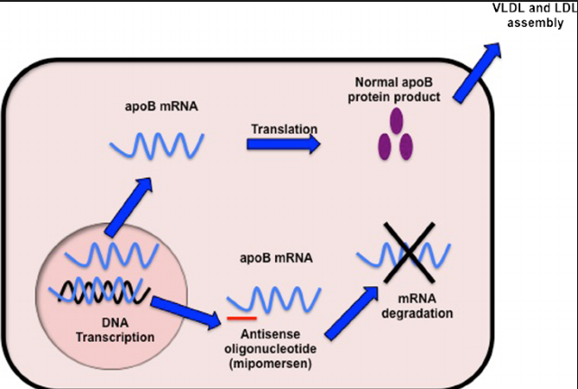
Kynamro
Mipomersen
          Homozygous familial hypercholesterolemia
          2013 refused by EMA
          Reasons for refusal
            High proportion of discontinuations mainly due to side effects
            Potential consequences of liver fat build up and increased enzyme elevations without sufficient measures to mitigate this potential risk
            More cardiovascular events

Slide 12
Exondys
Eteplirsen
          Duchenne muscular dystrophy
          2018 refused after re-examination by EMA
          8 vs 4 patients
          Very limited efficacy data and limited controlled period
          Efficacy data not convincing – translation into clinical effect
          Methodological limitations
          Very limited safety data
          Assessment of long term safety impossible
          Liver (elevated enzymes) and renal disorders (proteinuria) already observed

Slide 13
Waylivra
Volanesorsen
          Familial chylomicronemia syndrome
          Adjunct to diet
          2018 refused by FDA
          Risk of serious bleeding and thrombocytopenia—low blood platelet count
          New proposed dosing and platelet monitoring strategy had not been tested in clinical trials

Slide 14
Generally (known) safety aspects of AONs
Chemical modification likely to play a role in (common) side effects
          Injection site reactions
          Thrombocytopenia
          Flu-like symptoms
          ADA formation
          Hepatic toxicity
          Renal toxicity

Slide 15
Non-clinical aspects
There is no specific regulatory guidance from the EMA for the development of ASO’s
Guidelines M3 (Non-clinical safety studies for the conduct of human clinical trials for pharmaceuticals) and S6 (Preclinical safety evaluation of biotechnology-derived pharmaceuticals) applicable on case by case basis
Points for discussion:
Need for 2 species for general and reproduction toxicology studies?
Use of surrogate molecules
Need for carcinogenicity studies?
Make use of data from similar approved product
o But what is similar? Many different combinations of sugar modifications, linkers and conjugates are possible.
o Need for guideline on non-clinical requirements of ASO products (non-clinical working party)

Slide 16
3. Support Tools - Why Scientific Advice?
Hofer et al., 2015, Nat Rev Drug Discov

Slide 17
EMA’s early development advice service

Slide 18
ITF in numbers
Multidisciplinary platform for preparatory dialogue and orientation on innovative methods, technologies and medicines:
In 2020, 11 out of 27 meetings (41%) with academic developers
30% of the meetings concerned innovative methods to support the development of medicines
22% manufacturing technologies.

Slide 19
EMA’s early development advice service

Slide 20
Scientific Advice, PRIME and Qualification of novel methodologies in numbers

Slide 21
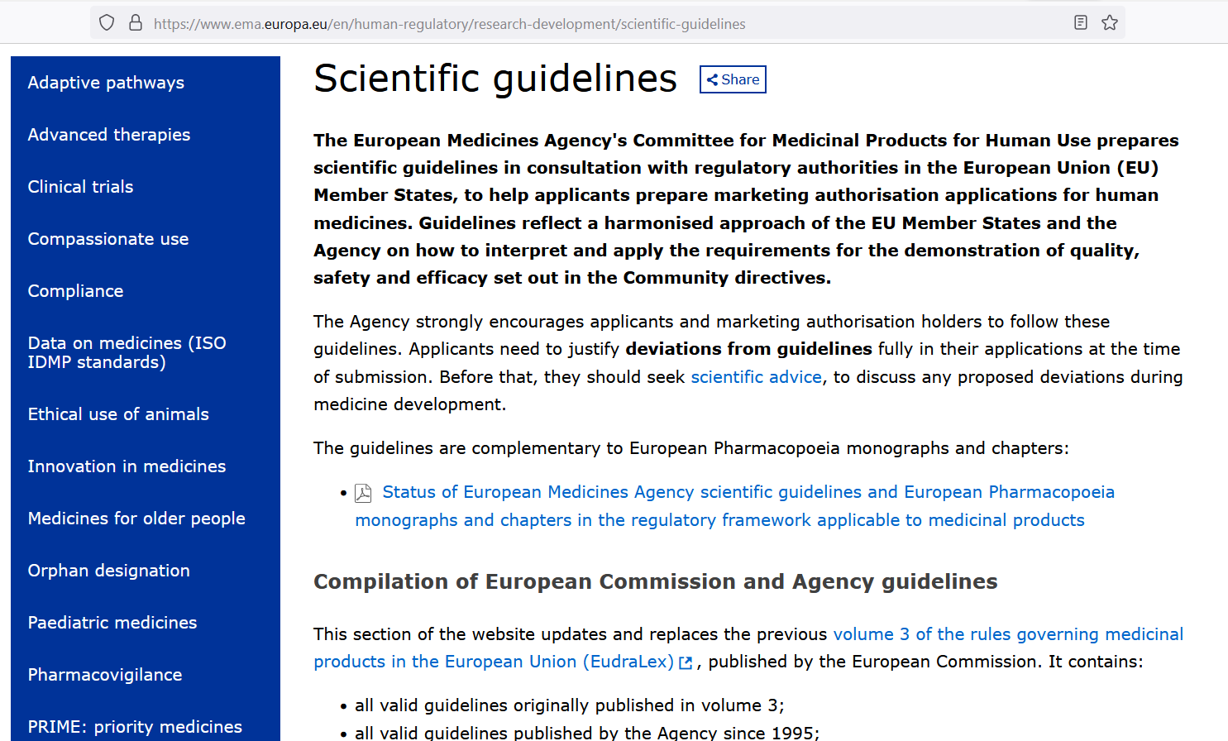
Regulatory Scientific Guidelines
For each step in the procedure: guidelines!
> 450 guidelines

Slide 22
EMA’s early development advice service

Slide 23
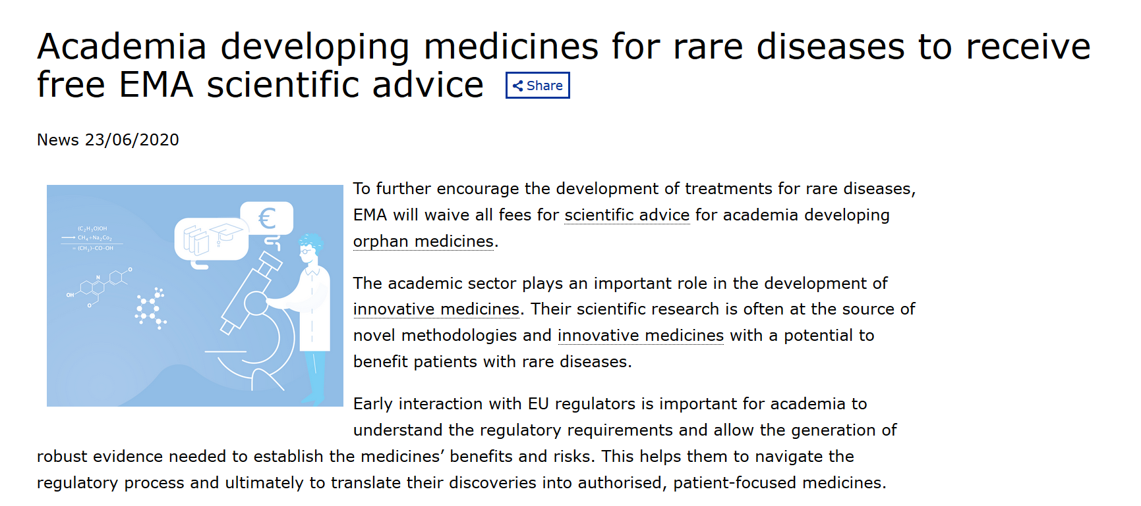
Orphan medicines
Gonzalez-Quevedo et al., 2020, Nat Rev Drug Discov

Slide 24
EMA’s early development advice service

Slide 25
National Scientific Advice
National advice is an important first contact point, and can be a first step for subsequently asking for advice on a European level.
Advantage on national level, face-to-face meeting, whereas at a European level a selection is made for which scientific advices a discussion meeting is held.
Tailor-made Scientific Advice (“Advies op Maat”)
https://www.cbg-meb.nl/onderwerpen/hv-wetenschappelijk-en-regulatoir-advies
nationalscientificadvice@cbg-meb.nl

Slide 26
Tailor-made Scientific Advice at MEB
Total of 47 accepted requests for tailor-made scientific advice (2015-2020):
15 requests by academia
24 requests by SME
8 requests by big pharma

Slide 27
Academia – FAQ
Quality
Mostly specific questions of product itself
E.g.: is our GMP chemistry strategy for the production of [product name] a suitable strategy?
Regulatory
What are the options for registration and which authorization procedure will be advised?
Would it be possible to request orphan designation?
Is it feasible and preferable to obtain marketing authorization by the academia (the applicant, being an endorsed centre of expertise)?
Pre-clinical
For existing medicines, is it necessary to reproduce toxicity studies or can existing data be used?
What should be known before a clinical trial is started and what is necessary for marketing registration?
ZIN
How do you make reimbursement possible by health insurance companies in the Netherlands?
Registration of a new indication is costly, the number of patients for the indication is limited in the Netherlands. If all costs should be paid by selling the drugs it would increase the price of [product name] substantially. Can this be avoided?
Clinical
Does the Agency agree to: study population, study design, study endpoints, placebo, statistical analysis, etc.?
Notes:
Hoe gevarieerd vragen zijn – welke route pakken – xxx.

Slide 28
Last but not least…
Make use of the possibilities to go for Scientific Advice for academia. Make also use of other support offices at your university/center, such as Technology Transfer Offices.
Difference in “language”. Don’t let it stop you. Important to have the dialogue.
Education is key to success.

Slide 29
science@cbg-meb.nl

Slide 30
Drug | Pivotal Phase 3 numbers (st vs plb) | Mode of action
Fomivirsen (Vitravene) | 34 vs 20 21 vs 11 | Binding mRNA – inhibition IE2 synthesis
Pegabtabin (Macugen) | 892 vs 298 (2 studies) | Antagonistic binding to target protein
Mipomersen (Kynamro) | 34 vs 17 | RNase H induced RNA degradation
Defibrotide (Defitelio) | 44 children 58 adults 32 historical controls | Non-specific protein interactions / unknown
Drisapersen (Kyndrisa) | 125 vs 61 | Splice switching (exon skipping)
Eteplirsen (Exondys) | 8 vs 4 | Splice switching (exon skipping)
Nusinersen (Spinraza) | 78 vs 43 | Splice switching (exon inclusion)
Inotersen (Tegsedi) | 112 vs 60 | selective binding mRNA
Volanesorsen (Waylivra) | 33 vs 34 | selective binding mRNA

